Slide 1
ListView in Android

Slide 2
ListView in Android
ListView in Android is a type of ViewGroup that shows the list of items in the form of rows.
In ListView the list layout is created using ListView.
It shows the list in vertical form and it becomes scrollable automatically.
It helps you to displaying the data in the form of a scrollable list.
Users can then select any list item by clicking on it.
example of ListView is your phone contact
Inside a ListView, we can show list of Text items by using TextView, or pictures using ImageView, or any other view or a combination of views.

Slide 3
ListView in Android
The list items are automatically inserted to the list using an Adapter that pulls content from a source such as an array or database.
To fill the data in a ListView we simply use adapters.
A Listitem is a piece of the interface which can be created by a number of View.

Slide 4
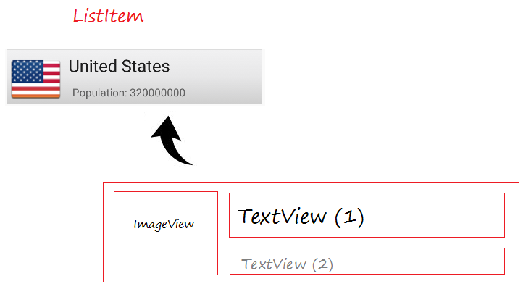

Slide 5
Attributes of ListView in Android
Id: id uniquely identifies a ListView.
Divider: This defines the color or drawable among different list items.
DividerHeight: This defines the height of the divider between list.
Items.listSelector: This property sets the selector for listView.
Entries: This specifies the reference to the array resource.
Background: It sets the background of the ListView. Background can be either color or even an image.
ChoiceMode: It sets the number of items that can be selected at once.
TextSize: It sets the size of the text that will be displayed.
Layout_width: It sets the width of the layout.
Layout_height: It sets the height of the layout.
Layout_gravity: It sets the gravity of the layout.

Slide 6
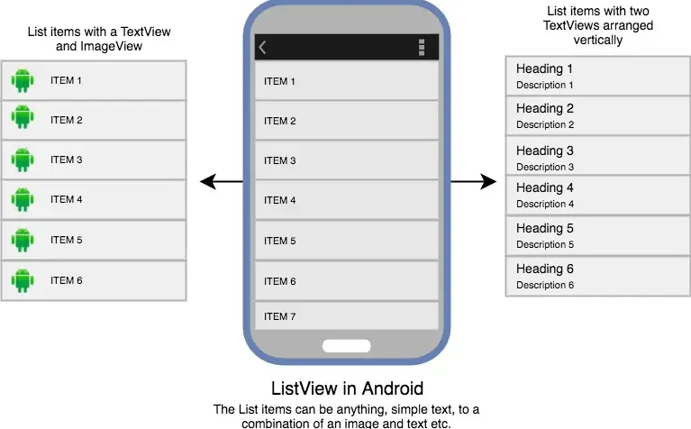

Slide 7
Simple list example
Create a new project ListDemo and activity Main Activity.
Here we will create a ListView in LinearLayout. (activity_main.xml )
Create a new activity name Listview for items. (activity_listview.xml)
use ArrayAdapter to display the subject names in UI
Define MainActivity.java

Slide 8
activity_main.xml
<?xml version="1.0" encoding="utf-8"?> <LinearLayout xmlns:android="http://schemas.android.com/apk/res/android" xmlns:app="http://schemas.android.com/apk/res-auto" xmlns:tools="http://schemas.android.com/tools" android:layout_width="match_parent" android:layout_height="match_parent" android:orientation="vertical" tools:context=".MainActivity" > <ListView android:id="@+id/subject_list" android:layout_width="match_parent" android:layout_height="match_parent" android:dividerHeight="5dp" android:divider="#0f1" android:listSelector="#f00" /> </LinearLayout>

Slide 9
activity_listview.xml
<?xml version="1.0" encoding="utf-8"?> <!-- Single List Item Design --> <TextView xmlns:android="http://schemas.android.com/apk/res/android" android:id="@+id/label" android:layout_width="fill_parent" android:layout_height="fill_parent" android:padding="10dip" android:textSize="25dip" android:textStyle="bold" > </TextView>

Slide 10
MainActivity.java
package com.example.listdemo; import androidx.appcompat.app.AppCompatActivity; public class MainActivity extends AppCompatActivity {
ArrayList<String> Sub_list= new ArrayList<>(); @Override protected void onCreate(Bundle savedInstanceState) { super.onCreate(savedInstanceState); setContentView(R.layout.activity_main);
Sub_list.add("Android");
Sub_list.add("Python"); ArrayAdapter<String> adapter = new ArrayAdapter<String>(this, R.layout.listview, Sub_list); ListView list1 = (ListView) findViewById(R.id.subject_list); list1.setAdapter(adapter); list1.setOnItemClickListener(new AdapterView.OnItemClickListener() { @Override public void onItemClick(AdapterView<?> adapterView, View view, int i, long l) { String value = "Your subject is " + adapter.getItem(i); /* Display the Toast */ Toast.makeText(getApplicationContext(), value, Toast.LENGTH_LONG).show(); } }); } }

Slide 11
// define adapter
ArrayAdapter<String> adapter = new ArrayAdapter<String>(this,R.layout.listview, Sub_list);
//design listView ListView list1 = (ListView) findViewById(R.id.subject_list);
// display list list1.setAdapter(adapter);
// add listener for click in individual items
list1.setOnItemClickListener(new AdapterView.OnItemClickListener() { @Override public void onItemClick(AdapterView<?> adapterView, View view, int i, long l) { String value = "Your subject is " + adapter.getItem(i); /* Display the Toast */ Toast.makeText(getApplicationContext(), value, Toast.LENGTH_LONG).show(); } });

Slide 12
Adding item to list
EditText newSubject=(EditText) findViewById(R.id.editTextTextPersonName); Button addNew=(Button) findViewById(R.id.button); addNew.setOnClickListener(new View.OnClickListener() { @Override public void onClick(View view) { Sub_list.add(newSubject.getText().toString()); adapter.notifyDataSetChanged(); } });

Slide 13
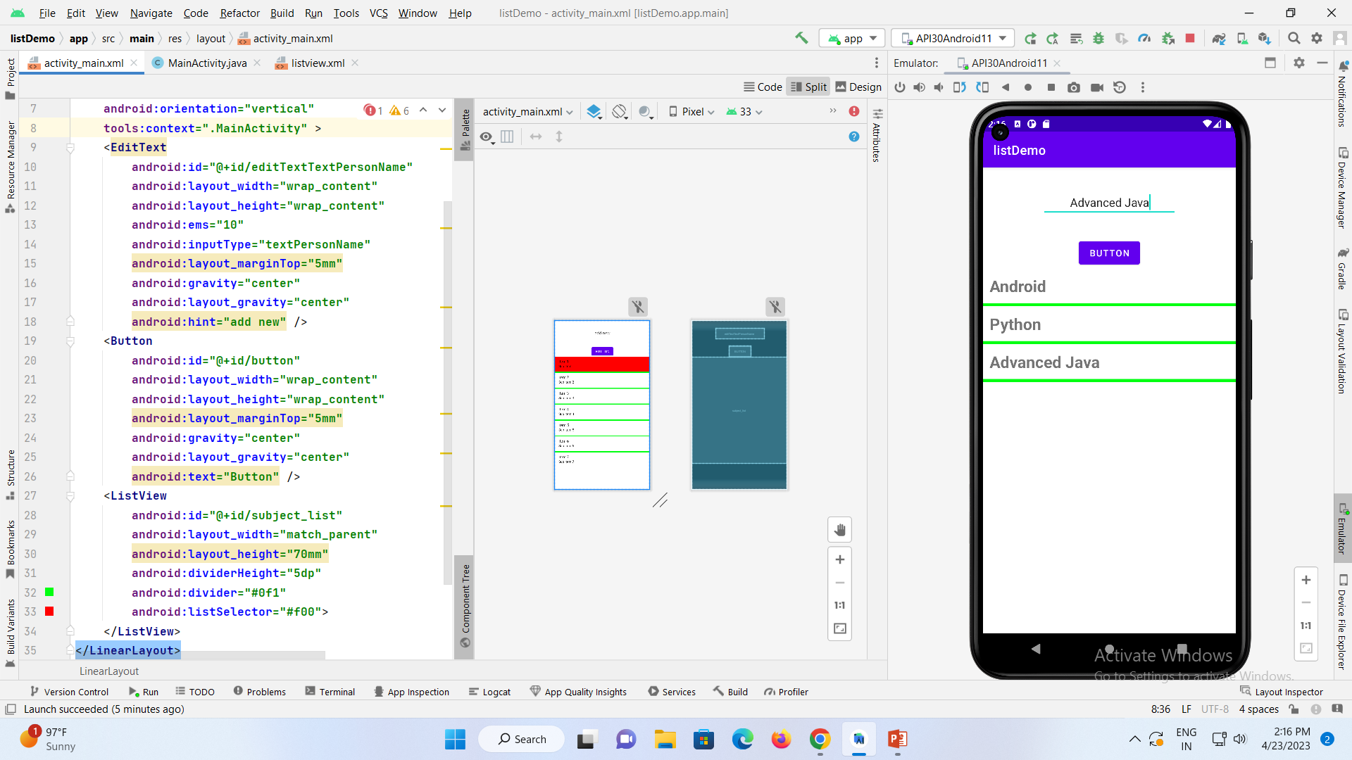

Slide 14
Android Date Time Picker Dialog
Android Date Time picker are used a lot in android apps
a Date Picker and Timer Picker Dialog in our android application.
Though a Date Picker and Time Picker can be used as independent widgets but they occupy more space on the screen
DatePickerDialog and TimePickerDialog classes have onDateSetListener() and onTimeSetListener() callback methods respectively.
These callback methods are invoked when the user is done with filling the date and time respectively.

Slide 15
DatePickerDialog class
The DatePickerDialog class consists of a 5 argument constructor with the parameters listed below.
1. Context: It requires the application context
2. CallBack Function: onDateSet() is invoked when the user sets the date with the following parameters:
3. int year : It will be store the current selected year from the dialog
4. int monthOfYear : It will be store the current selected month from the dialog
5. int dayOfMonth : It will be store the current selected day from the dialog
int mYear : It shows the the current year that’s visible when the dialog pops up
int mMonth : It shows the the current month that’s visible when the dialog pops up
int mDay : It shows the the current day that’s visible when the dialog pops up

Slide 16
Methods of DatePicker
setSpinnersShown(boolean shown):
getDayOfMonth():
getMonth():
getYear():
getFirstDayOfWeek():

Slide 17
Attributes of DatePicker
<DatePicker
android:id="@+id/simpleDatePicker"
android:layout_width="wrap_content"
android:layout_height="wrap_content"
android:datePickerMode="spinner"
android:padding="40dp"/><!-- 40dp padding from all the sides of a date picker -->

Slide 18
<?xml version="1.0" encoding="utf-8"?> <LinearLayout xmlns:android="http://schemas.android.com/apk/res/android" xmlns:app="http://schemas.android.com/apk/res-auto" xmlns:tools="http://schemas.android.com/tools" android:layout_width="match_parent" android:layout_height="match_parent" android:orientation="vertical" tools:context=".MainActivity" > <DatePicker android:id="@+id/simpleDatePicker" android:layout_width="477dp" android:layout_height="wrap_content" android:datePickerMode="calendar" /> <Button android:id="@+id/submitButton" android:layout_width="180dp" android:layout_height="wrap_content" android:layout_centerHorizontal="true" android:layout_marginTop="50dp" android:background="#150" android:text="SUBMIT" android:textColor="#fff" android:textSize="20sp" android:textStyle="bold" /> </LinearLayout>

Slide 19
package com.example.datatimedemo; import androidx.appcompat.app.AppCompatActivity; public class MainActivity extends AppCompatActivity { DatePicker simpleDatePicker; Button submit; @Override protected void onCreate(Bundle savedInstanceState) { super.onCreate(savedInstanceState); setContentView(R.layout.activity_main); simpleDatePicker = (DatePicker) findViewById(R.id.simpleDatePicker); submit = (Button) findViewById(R.id.submitButton); submit.setOnClickListener(new View.OnClickListener() { @Override public void onClick(View view) { String day = "Day = " + simpleDatePicker.getDayOfMonth(); String month = "Month = " + (simpleDatePicker.getMonth() + 1); String year = "Year = " + simpleDatePicker.getYear(); Toast.makeText(getApplicationContext(), day + "\n" + month + "\n" + year,Toast.LENGTH_LONG).show(); } }); } }

Slide 20
TimePickerDialog class
The TimePickerDialog class consists of a 5 argument constructor with the parameters listed below.
Context: It requires the application context
CallBack Function: onTimeSet() is invoked when the user sets the time with the following parameters:
int hourOfDay : It will be store the current selected hour of the day from the dialog
int minute : It will be store the current selected minute from the dialog
int mHours : It shows the the current Hour that’s visible when the dialog pops up
int mMinute : It shows the the current minute that’s visible when the dialog pops up
boolean false : If its set to false it will show the time in 24 hour format else not

Slide 21
TimePicker attributes
<TimePicker
android:id="@+id/simpleTimePicker"
android:layout_width="wrap_content"
android:layout_height="wrap_content"
android:timePickerMode="spinner"/>

Slide 22
Methods of TimePicker:
setCurrentHour(Integer currentHour):
setCurrentMinute(Integer currentMinute):
setMinute(Integer minute):
getCurrentHour():
getHour().
setIs24HourView(Boolean is24HourView):
is24HourView():
setOnTimeChangedListener(TimePicker.OnTimeChangedListener onTimeChangedListener):

Slide 23
<?xml version="1.0" encoding="utf-8"?> <LinearLayout xmlns:android="http://schemas.android.com/apk/res/android" xmlns:app="http://schemas.android.com/apk/res-auto" xmlns:tools="http://schemas.android.com/tools" android:layout_width="match_parent" android:layout_height="match_parent" android:orientation="vertical" tools:context=".MainActivity" > <TimePicker android:id="@+id/simpleTimePicker" android:layout_width="wrap_content" android:layout_height="wrap_content" android:layout_centerHorizontal="true" android:layout_marginTop="50dp" android:padding="20dp" android:timePickerMode="spinner" /> <TextView android:id="@+id/time" android:layout_width="wrap_content" android:layout_height="wrap_content" android:layout_centerHorizontal="true" android:layout_marginTop="10mm" android:text="Time Is ::" android:textColor="#090" android:textSize="20sp" android:textStyle="bold" /> </LinearLayout>

Slide 24
package com.example.datatimedemo; import androidx.appcompat.app.AppCompatActivity; public class MainActivity extends AppCompatActivity { TextView time; TimePicker TimePicker1; @Override protected void onCreate(Bundle savedInstanceState) { super.onCreate(savedInstanceState); setContentView(R.layout.activity_main); time = (TextView) findViewById(R.id.time); TimePicker1 = (TimePicker) findViewById(R.id.simpleTimePicker); //TimePicker1.setIs24HourView(false); TimePicker1.setOnTimeChangedListener(new TimePicker.OnTimeChangedListener() { @Override public void onTimeChanged(TimePicker view, int hourOfDay, int minute) { // display a toast with changed values of time picker Toast.makeText(getApplicationContext(), hourOfDay + " " + minute, Toast.LENGTH_SHORT).show(); time.setText("Time is :: " + hourOfDay + " : " + minute); // set the current time in text view } }); } }

